Slide 1
CSCI 561 Foundations of Artificial Intelligence
Professor Wei-Min Shen
Session 23: Reinforcement-Learning

Slide 2
Markov Decision Process
Markov Decision Process
We learned that a Markov Decision Process (MDP) consists of
A set of states S (with an initial state s₀)
A set of actions A in each state,
A set of percepts that can be sensed
A transition model P(s’|s,a), or T(s,a,s’)
The current state distribution
A reward function R(s,a,s’)
The MDP’s solution identifies the best action to take in each state
Optimal policy π(s)=a obtained by value iteration or policy iteration (aka dynamic programming)

Slide 3
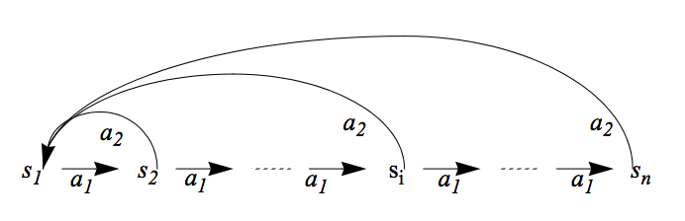
An Example for MDP
Given
States: s₁, …, s_{n,} Actions: a₁, a₂
Transition Probability Distribution: (assume s_{n+1}=s₁)
P(s_{i},a₁,s_{i+1})=0.8, P(s_{i},a₁,s₁)=0.2, P(s_{i},a₂,s₁)=0.9, P(s_{i},a₂,s_{i+1})=0.1.
Reward: all R(s_{i}, a_{i}, s_{j}) = 0.0, except R(s_{n-1}, a₁, s_{n}) = 99.9
We define the goal state to be s_{n}
The Future discount factor: gamma = 0.7
State Utilities: U(s_{n-1}), U(s_{n-2}), U(s_{n-3}), … and U(s₂), U(s₁)
Optimal Policy: π(s_{i})=a₁
99.9
Goal

Slide 4
Reinforcement Learning
Given a Markov Decision Process (environment)
A set of states S ✔ (known)
A set of actions A in each state ✔ (known)
A set of percepts that can be sensed ✔ (known)
The current state ✔ (known)
Transitions P(s’| s, a) ✖ (only known by the env)
Rewards R(s, a, s’) ✖ (only known by the env)
Could the agent still learn the optimal policy?

Slide 5
Goals, Rewards, Utilities, Policies
Goals
Given to the agent from the problem statements
Rewards
Given to the agent, designed based on the goals
Utility or Values for states
Computed by the agent, based on the rewards
Policies
Computed or learned by the agent
Used by the agent to select its actions
The better a policy, the more rewards it collects

Slide 6
Reinforcement Learning Propagating the Delayed Rewards
G
G
Before RL
After RL
After RL, no matter where you are, you know which way to go to the Goal!

Slide 7
Reinforcement Learning (Key Ideas)
Can the agent still learn the optimal policy?
When it knows only the states S and actions A, but not the transition model P(s,a,s’) and/or reward function R(s,a,s’)
Try an action on a state of the environment, and get a “sample” that includes (s, a, s’, r) and maybe U:
A state transition (s,a)→s’
A reward received for the action r = R(s, a, s’)
And maybe the value/utility of the next state U(s’)
Objective: Try different actions in states to discover an optimal policy π(s)=a and eventually tells the agent which action will lead to the most rewarding states

Slide 8
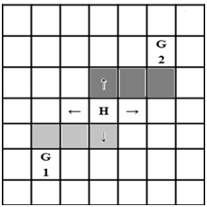
How to Explore the State Space
Visit different states to discover a policy and improve it
Numerous strategies
A simple strategy is executing actions randomly
Initially there is no policy, but random actions eventually discover a policy
At every time step, act randomly with a probability, otherwise, follow the current policy π(s)=a
The random action may causes unnecessary action execution when the optimal policy is already discovered
One solution is to lower the probability of selecting a random action over time

Slide 9
Reinforcement Learning
Objective: Learn the optimal policy π*(s)=a
Two general classes of algorithms:
Model-based RL
First learn the model and utilities (state values), then learn the policy (e.g., policy iteration)
Model-free RL
Learn the policy without learning an explicit model, but by receiving “samples” from the environment
Three algorithms we will learn:
Monte Carlo
Temporal Difference
Q-Learning

Slide 10
An Example for Model-Based RL
Given
States: s₁, …, s_{n,} Actions: a₁, a₂
Transition Probability Distribution: (assume s_{n+1}=s₁)
P(s_{i},a₁,s_{i+1})=0.8, P(s_{i},a₁,s₁)=0.2, P(s_{i},a₂,s₁)=0.9, P(s_{i},a₁,s_{i+1})=0.1.
Reward: all R(s_{i}, a_{i}, s_{j}) = 0.0, except R(s_{n-1}, a₁, s_{n}) = 99.9
The Future discount factor: gamma = 0.7
Try to learn: U(s_{n-1}), U(s_{n-2}), U(s_{n-3}), … and U(s₂), U(s₁)
99.9

Slide 11
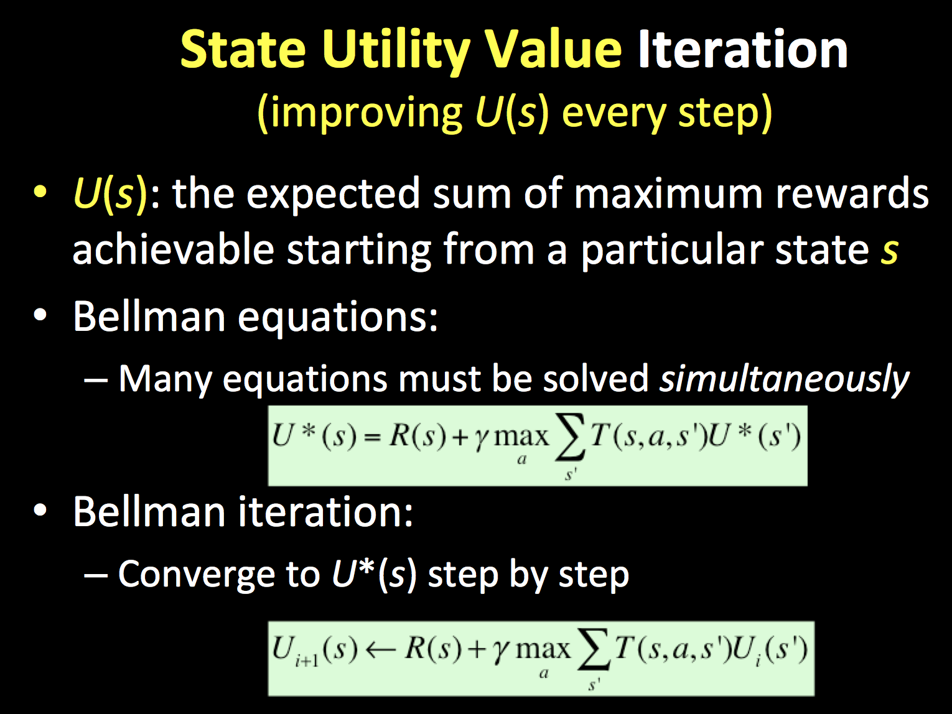
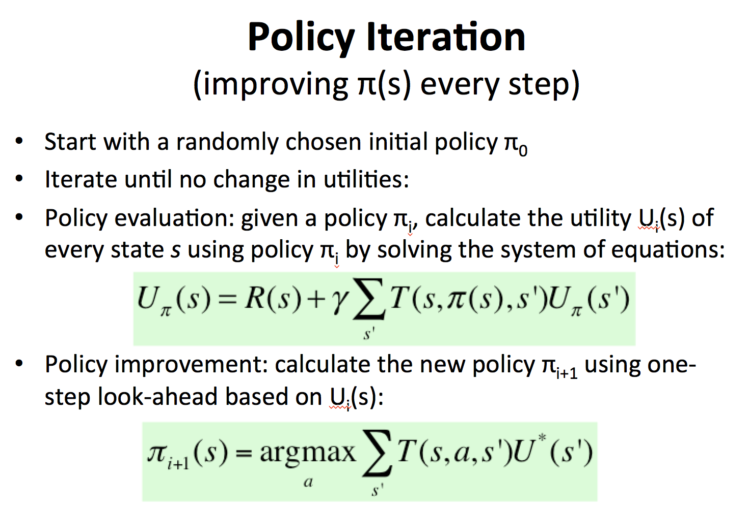
Model-Based RL
Learn an approximate model based on random actions
From a state s, count outcomes of s’ for each (s, a)
Normalize to give an estimate of P(s, a, s’)
Learn state utility U(s) from rewards R(s, a, s’) when encountered
Solve the learned MDP and obtain a policy (e.g., policy iteration)

Slide 12
State Utility Value Iteration (improving U(s) every step)
U(s): the expected sum of maximum rewards achievable starting from a particular state s
Bellman equations:
Many equations must be solved simultaneously
Bellman iteration:
Converge to U*(s) step by step

Slide 13
Policy Iteration (improving π(s) every step)
Start with a randomly chosen initial policy π₀
Iterate until no change in utilities:
Policy evaluation: given a policy π_{i}, calculate the utility U_{i}(s) of every state s using policy π_{i} by solving the system of equations:
Policy improvement: calculate the new policy π_{i+1} using one‐step look‐ahead based on U_{i}(s):

Slide 14
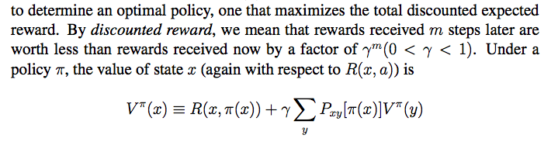
Compute Utility from Rewards and Policy
Transition: P(y|x,a)
P_{xy}[a]
y₁
V(y₁)
Assume the transitions are known
V(x)
x
y₂
V(y₂)
Rewards: R(x,a)
Policy: a=π(x)
y_{l}
V(y_{j})

Slide 15
An Example for Model-Based RL
Given
States: s₁, …, s_{n,} Actions: a₁, a₂
Transition Probability Distribution: (assume s_{n+1}=s₁)
P(s_{i},a₁,s_{i+1})=0.8, P(s_{i},a₁,s₁)=0.2, P(s_{i},a₂,s₁)=0.9, P(s_{i},a₁,s_{i+1})=0.1.
Reward: all R(s_{i}, a_{i}, s_{j}) = 0.0, except R(s_{n-1}, a₁, s_{n}) = 99.9
We define the goal state to be s_{n}
The Future discount factor: gamma = 0.7
U(s_{n-1})=99.9, U(s_{n-2})~=70, U(s_{n-3})~=49, … and U(s₁)~=99.9*0.7^{n}
99.9

Slide 16
Model-Based RL
Learn an approximate model based on random actions
From a state s, count outcomes of s’ for each (s, a)
Normalize to give an estimate of P(s, a, s’)
Learn state utility U(s) from rewards R(s, a, s’) when encountered
Solve the learned MDP and obtain a policy (e.g. policy iteration)
Pros:
If and when the goal changes, one can use the learned model P(s, a, s’) to recalculate U(s) and compute a new policy offline
Cons:
Larger representation than model-free RL

Slide 17
Reinforcement Learning
Objective: Learn the optimal policy π*(s)=a
Model-based RL
First learn the model and utilities (state values), then learn the policy (e.g., policy iteration)
Model-free RL
Learn the policy without learning an explicit model, but by receiving “samples” from the environment
Three algorithms we will learn:
Monte Carlo
Temporal Difference
Q-Learning

Slide 18
Monte Carlo RL (model free)
Generate a fixed policy π(s) = a based on U(s)
In each episode, the learner follows the policy starting at a random state
Average the sampled returns originating from each state
Generate a policy based on U(s) as in “policy iteration”
Cons:
The utility of states U(s) is given and fixed (not learned)
Works only in episodic problems
Takes a very long time to converge as learning is from complete sample returns
Wastes information as it figures out state values in isolation from other states

Slide 19
Temporal Difference RL (model free)
Improve Monte Carlo, still using a fixed policy
Update U(s) using each sample (s, a, s’, r) received from the environment and each sample includes:
A state transition (s,a)→s’ done by the environment
A reward received for the action r = R(s, a, s’)
And the value of the next state U(s’)
That is, Sample = r + γU(s’), where γ = future discount
TD Algorithm:
U(s) ← (1-α)U(s) + α*Sample = (1-α)U(s) + α[r+γU(s’)]
Where α is the “learning rate” (how much you trust the sample)
You might decrease α over time when converges to the average
The parameter α also represents “forgetting long past values”
Cons:
Only provides the utility of states, not improve policy directly

Slide 20
An Example for TD-RL
Given
States: s₁, …, s_{n,} Actions: a₁, a₂
Transition Probability Distribution: (assume s_{n+1}=s₁)
P(s_{i},a₁,s_{i+1})=0.8, P(s_{i},a₁,s₁)=0.2, P(s_{i},a₂,s₁)=0.9, P(s_{i},a₁,s_{i+1})=0.1.
Reward: all R(s_{i}, a_{i}, s_{j}) = 0.0, except R(s_{n-1}, a₁, s_{n}) = 99.9
We define the goal state to be s_{n}
The learning rate alpha = 0.4
The Future discount factor: gamma = 0.7
Learn use TD algorithm: U(s_{n-1}), U(s_{n-2}), U(s_{n-3}), … and U(s₂), U(s₁)
99.9

Slide 21
Q-Learning (Definition)
The key idea is to use Q(s,a) to represent the value of taking an action a in state s, rather than only the value of state U(s):
Define:
Optimal π(s) = argmax U^{π} (s) = argmax_{a} Q(s, a)
The last term using Q to replace U

Slide 22
Q-Learning (Algorithm)
Initially, let Q(s, a)=0, learning rate α
Sample a transition and reward (s,a,s’,r)
Sample = r + γ max_{a’} Q(s’,a’)
Q(s,a) = (1-α)Q(s,a) + α*Sample
r
a’
S’
s
a
Advantages:
No need for a fixed policy, can do off-policy learning, or directly learns a policy
The optimal policy π(s)=a is to select the action a that has the best Q(s, a)
Provably convergent to the optimal policy when t -> infinite

Slide 23
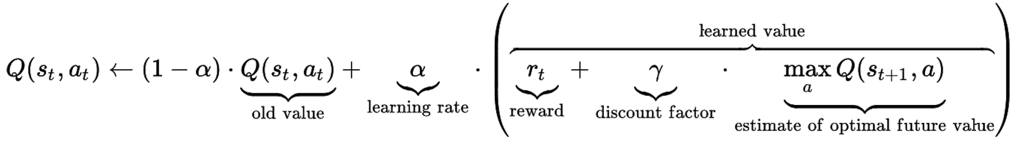
Q-Learning (in One Formula)

Slide 24
An Example for Q-Learning
Given
States: s₁, …, s_{n,} Actions: a₁, a₂
Transition Probability Distribution: (assume s_{n+1}=s₁)
P(s_{i},a₁,s_{i+1})=0.8, P(s_{i},a₁,s₁)=0.2, P(s_{i},a₂,s₁)=0.9, P(s_{i},a₁,s_{i+1})=0.1.
Reward: all R(s_{i}, a_{i}, s_{j}) = 0.0, except R(s_{n-1}, a₁, s_{n}) = 99.9
We define the goal state to be s_{n}
The learning rate alpha = 0.4
The Future discount factor: gamma = 0.7
Try to learn: Q(s_{n-1},a₁), Q(s_{n-1},a₂), Q(s_{n-2},a₁), and Q(s_{n-2},a₂)=?
99.9

Slide 25
An Example for Q-Learning
Initially: all Q(s_{i}, a_{j}) = 0.0
Assume you got two samples at the state s_{n-1} for action a₁
s_{n-1},a₁, s_{n}, r=R(s_{n-1},a₁, s_{n})=99.9, // P(s_{n-1},a₁)→s_{n}
s_{n-1},a₁, s₁, r=R(s_{n-1},a₁, s₁)=0.0, // P(s_{n-1},a₁)→s₁
Updated Q value, if P(s,a) are known:
Q(s_{n-1},a₁)= 0.8*[99.9 + 0.7*0.0] + 0.2[0.0+0.7*0.0] = 79.9
If P(s,a) are unknown: sample₁ = 99.9+.7*0; sample₂=0+.7*0
Q(s_{n-1},a₁)= (1-0.4)*0.0 + 0.4*99.9 = 39.96
Q(s_{n-1},a₁)= (1-0.4)*39.96 + 0.4*0.0 = 23.976
99.9

Slide 26
Summary of RL
Pros:
Easy to use in problems where the data can be mapped to states easily
Guaranteed to find the optimal policy given enough time even with suboptimal actions
Cons:
States of the environment are not always known
Computation time is intractable for large or continuous state spaces
E.g. if each cell in a grid world is a state, then state space grows exponentially with number of rows and columns (states = map size = m*n)
Cannot handle raw data, must use an approximation/reduction function
Designing approximation functions to disambiguate similar states requires human intelligence or an alternate learning technique
E.g. use the relative distance (states = m*n) between two agents in a hunter-prey problem as opposed to their cell coordinates (states = m*n*m*n)
Model-free RL cannot transfer the learned knowledge when the goal changes
Forgetting a learned policy is much more difficult (hysteresis), quicker to start from scratch

